Slide 1
EMPLOYEES PERFORMANCE ON SALES
PRESNTED BY: ISSAC JABASTIN S
REGISTER ID:312204474 , 684E47405852A90960040E3F222F7A27
DEPARTMENT:COMMERCE
COLLEGE:K.C.S.KASI NADAR COLLEGE ARTS & SCIENCE

Slide 2
PROJECT TITLE
SALES REGIONWISE

Slide 3
AGENDA:
PROBLEM
PROJECT OVERVIEW
END USERS
OUR SOLUTION AND PROPOSITION
DATASET DESCRIPTION
MODELLING APPROACH
RESULTS AND DISCUSSION
CONCLUSION

Slide 4
PROBLEM STATEMENT:
The main problem is the inconsistent sales performance across regions, which is impacting overall company revenue and growth potential. Specifically:
Underperformance: Certain regions are not meeting their sales targets, leading to lower revenue than projected.
Overperformance Analysis: While some regions exceed targets, the strategies and factors contributing to their success are not fully understood or replicated in other regions.
Resource Allocation: There may be inefficiencies in how resources are allocated and utilized across different region

Slide 5
OVERIEW ABOUT SALES REGIONWISE
Understanding sales performance on a regional basis involves analyzing how different areas or territories contribute to a company's overall revenue and growth. Here’s an overview of key aspects related to sales performance regionwise:
SALES REGION DEFINES
PERFORMANCE METRICS
REGIONAL DEFINES
SALES STRATAGIES
CHALLENGES
OPPORUNITIES
TOOLS AND TECHNIQUES
KEY PERFORMANCE INDICATORS ( KPI )

Slide 6
WHO ARE THE END USERS
EMPLOYEES
EMPLOYERS
ORGANISATION
BUSINESS PEOPLE

Slide 7
OUR SOLUTION AND ITS VALUE PROPOSITION
FILTERING: REMOVE MISSING VALUES
CONDITIONAL FORMATING:BLANKS
PIVOT TABLE:SUMMARY OF EMPLOYEE PERFORMANCE
FORMUALS:IFS
GRAPHS:FINAL REPORT

Slide 8
DATA DESCRIPTION
OrderNumber: A unique identifier for each order.
Sales Channel: The channel through which the sale was made (In-Store, Online, Distributor, Wholesale).
WarehouseCode: Code representing the warehouse involved in the order.
ProcuredDate: Date when the products were procured.
OrderDate: Date when the order was placed.
ShipDate: Date when the order was shipped.
DeliveryDate: Date when the order was delivered.
SalesTeamID: Identifier for the sales team involved.
CustomerID: Identifier for the customer.
StoreID: Identifier for the store.

Slide 9
MODELLING
DATA SET : EMPLOYEE DATASET
FEATURE SELECTION
DATA CLEANING : MISSING VALUES,IRRELEVANT
FORMULA PERFORMANCE CALCULATION,LOW,MED,HIGH
PIVOT TABLE SUMMARY,BUSINESS UNIT,GENDER,EMPLYMENT TYPE,EMPLOYEE ID,PERFORMANCE
CHART : REPORT : SLICER

Slide 10
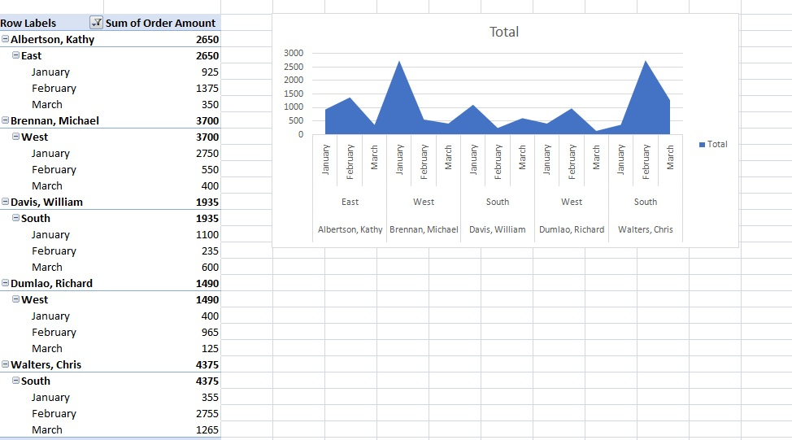
RESULT

Slide 11
CONCLUSION
The sales REGIONWISE performance has been instrumental in driving our company’s growth and profitability. Each team within the department has demonstrated strengths in various areas, from customer acquisition to account management and strategic sales initiatives. The analysis reveals that while there have been notable successes, there are also areas requiring improvement.
To sustain and build on our successes, it is essential to address the identified challenges and leverage the opportunities for growth. Enhancing training programs, optimizing sales processes, and increasing cross-departmental collaboration will be critical in achieving our sales targets and improving overall performance.

